Slide 1
iMoment
Group 14
HU Bing 1155151103
CHEN Jiaxian 1155152636
SUN Suwei 1155152413
Notes:
Group members
Order of presentation: features, each feature show you the screenshot of it, and then describe how we implement the feature, mainly focus on how the tables in the database are designed, and the APIs are designed.
Also in the homepage of our github reposi

Slide 2
Features
Under Development
Demo
Notes:
So are you can see from the content, we design four features which are respectively:

Slide 3
Features

Slide 4
Features
01
02
User Login / Register
Add friends via User ID
03
04
Private Chat / Chatroom
Moment
Notes:
So are you can see from the content, we design four features which are respectively:

Slide 5
User Login & Register
Feature.01
Notes:
First let me introduce you the features no.1,

Slide 6
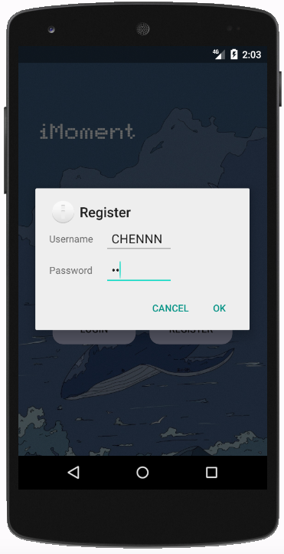
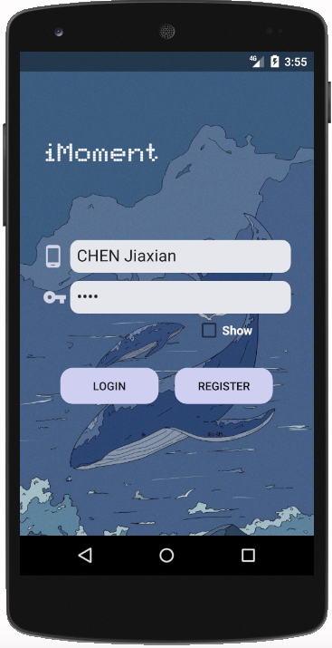
Register
Login

Slide 7
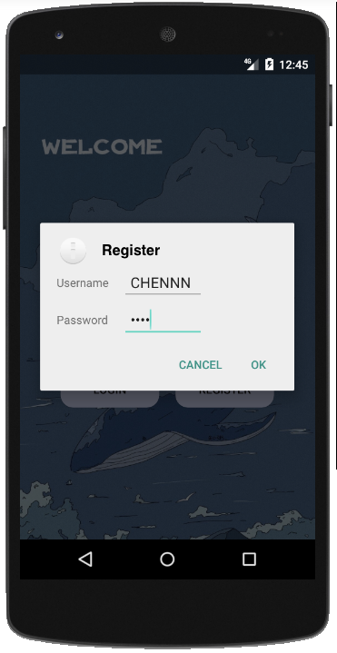
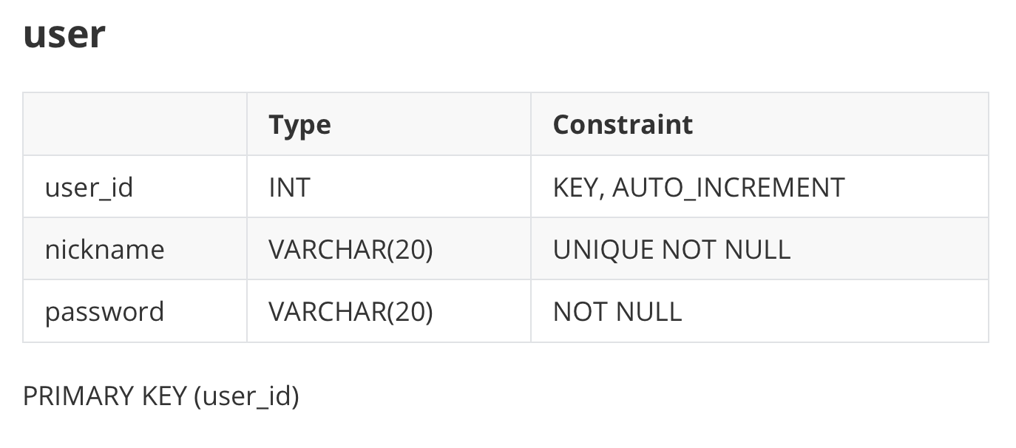
APIs:
POST /api/project/register
IN: (username, password)
OUT: (id, status)
POST /api/project/login
IN: (username, password)
OUT: (status)
Notes:
To implement this feature, we just simply use one table and two apis.
When the front-end give the request of user

Slide 8
Add friends via User ID
Feature.02

Slide 9
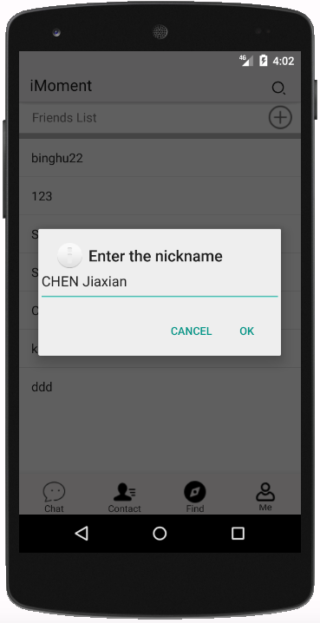
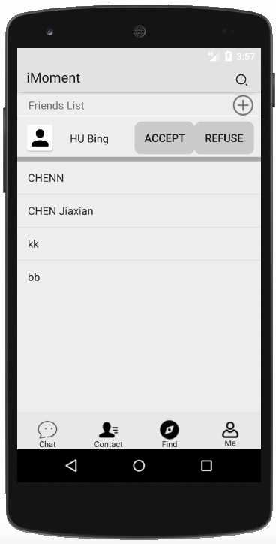
Add friend
Accept / Refuse

Slide 10
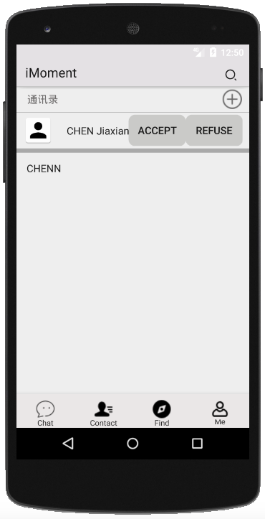
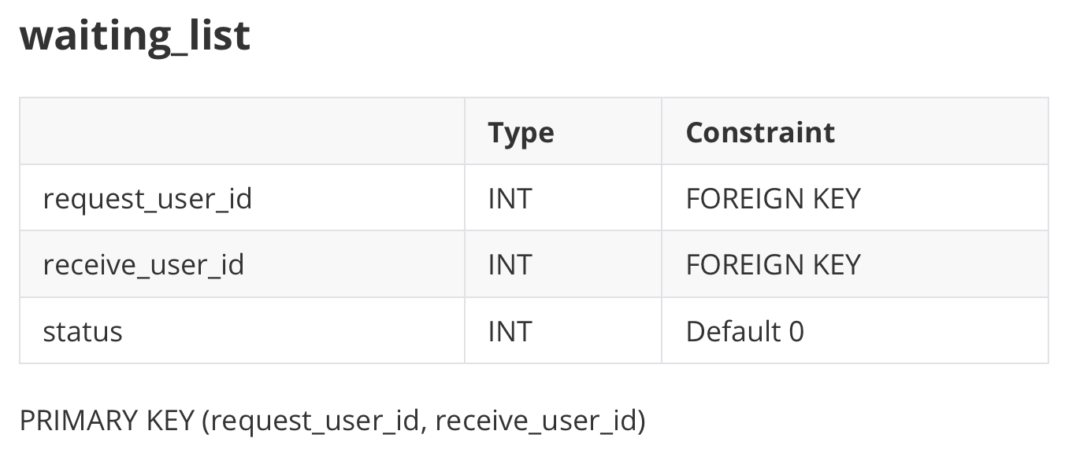
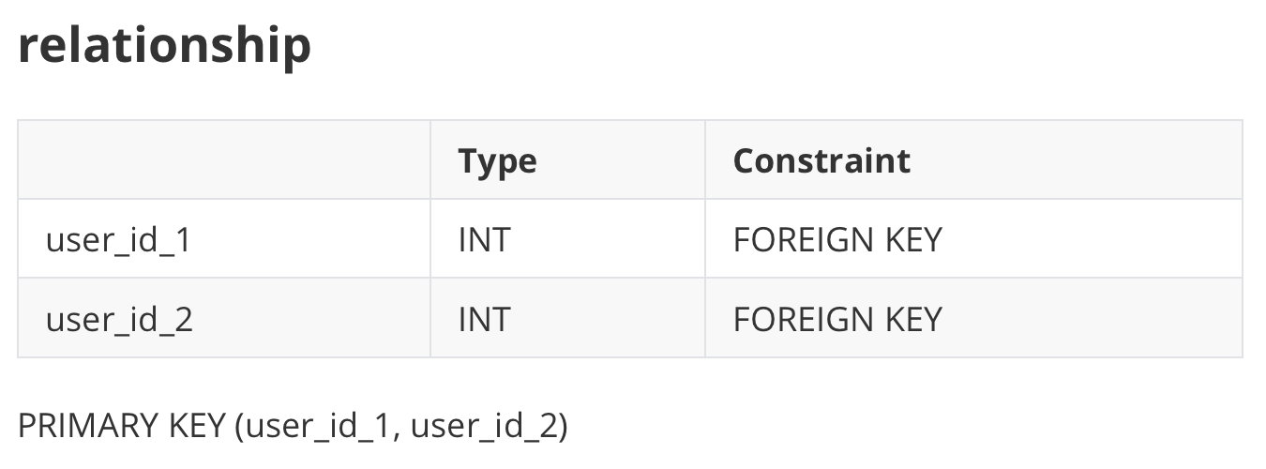
Add friends via User ID
APIs:
Get /api/project/get_friends
IN: (user_id)
OUT: (status, data{nickname})
GET /api/project/get_friend_request
IN: (user_id)
OUT: (status, data{nickname})
POST /api/project/add_friend
IN: (request_id, receive_nickname)
OUT: (status)
GET /api/project/accept_or_refuse
IN: (operation, request_name, receive_id)
OUT: (status)

Slide 11
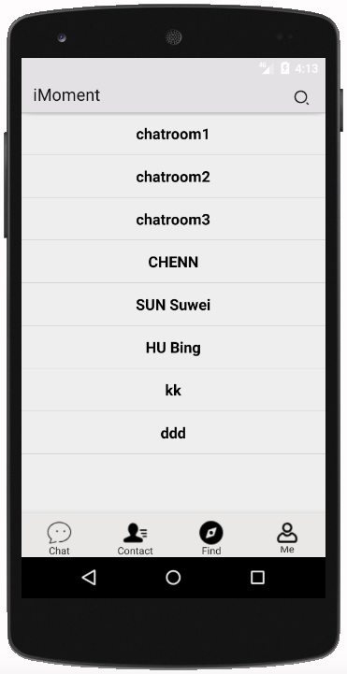
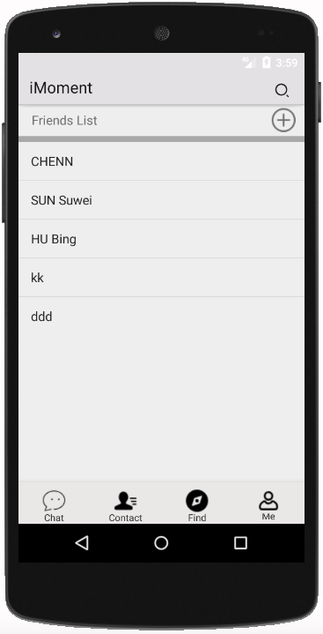
Chat List
Friends List

Slide 12
Private Chat & Chatroom
Feature.03

Slide 13
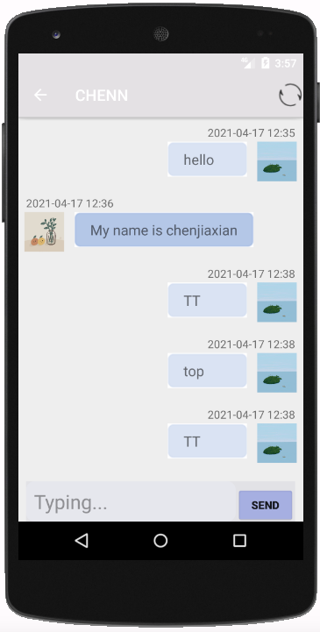
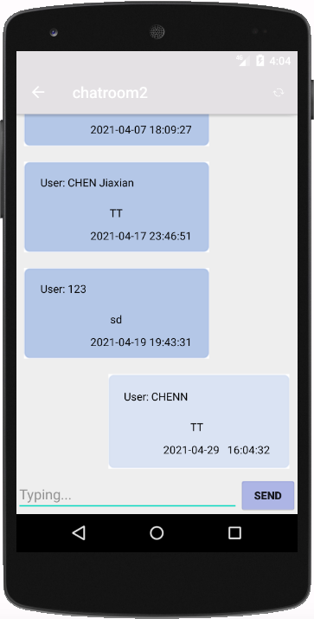
Private Chat
Chatroom

Slide 14
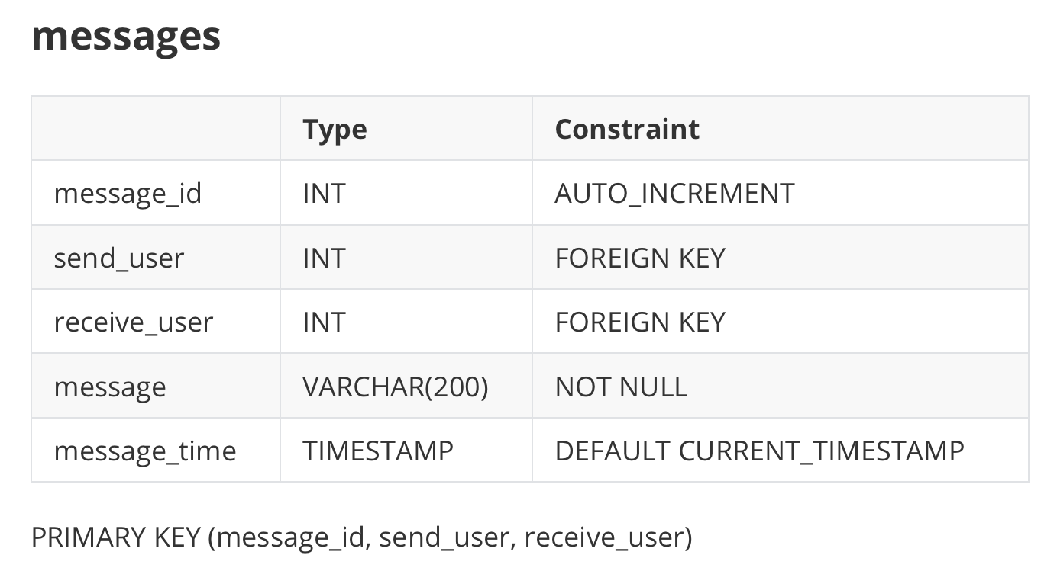
Private Chat & Chatroom
APIs:
GET /api/project/messages
IN: (curr_user, target_user)
OUT: (status, data{message, message_id, message_time, receive_user, send_user})
POST /api/project/messages
IN: (send_user, receive_user, message)
OUT: (status)

Slide 15
Moment
Feature.04

Slide 16
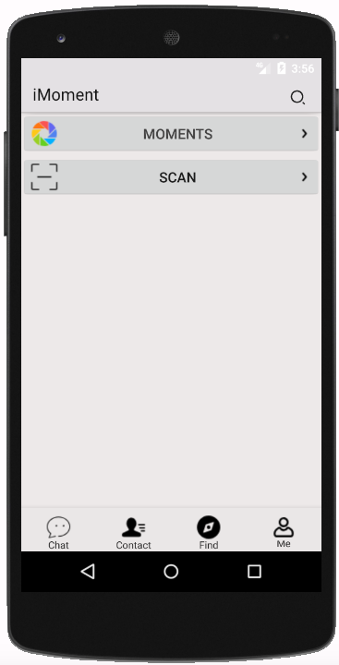
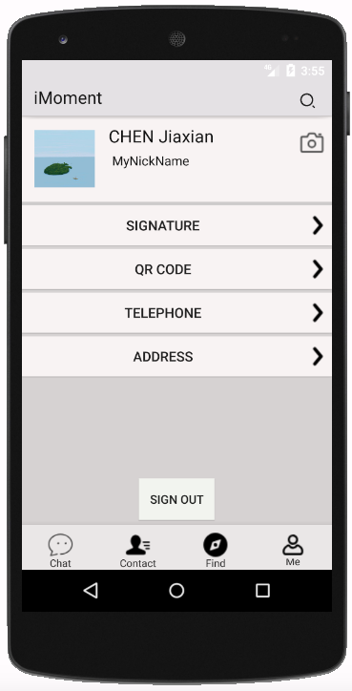
Find
Me

Slide 17
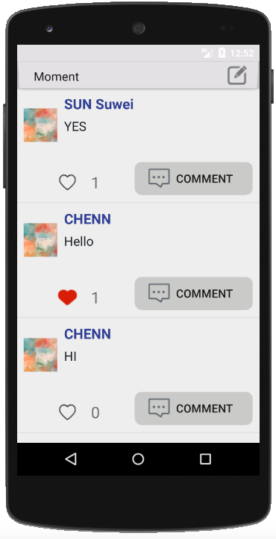
Moment & Give a ”like”

Slide 18
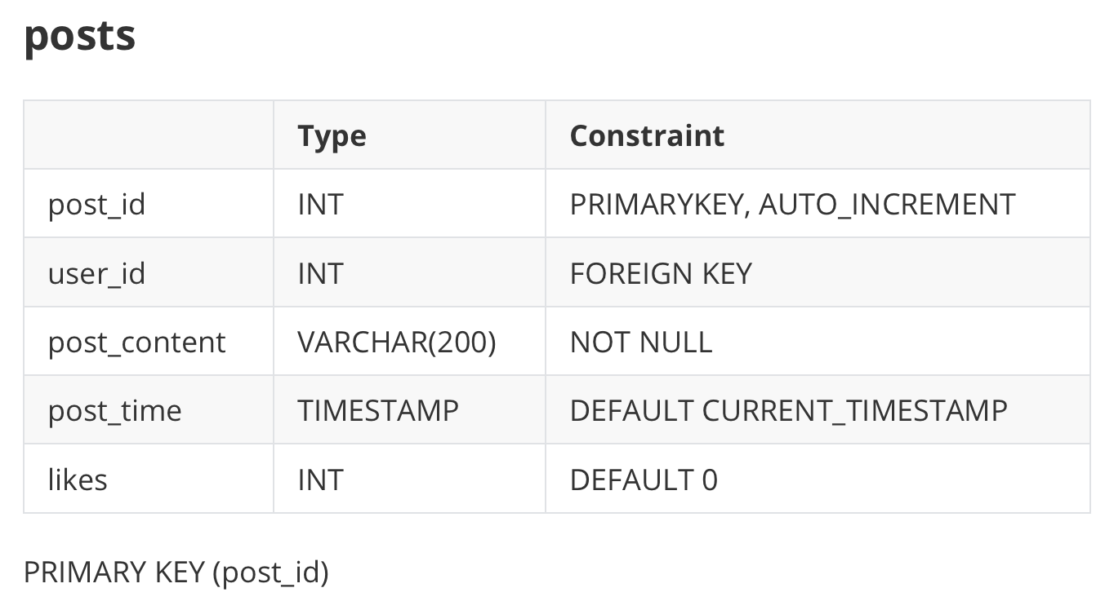
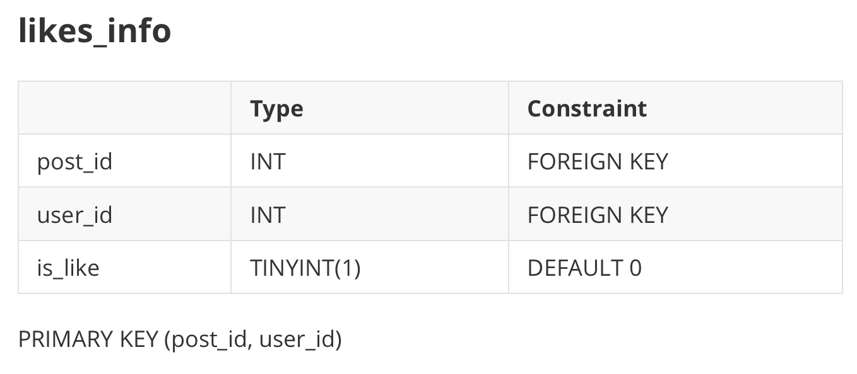
Moment & give a like
APIs:
POST /api/project/posts
IN: (user_id, posts_content)
OUT: (status)
GET /api/project/posts
IN: (user_id, receive_user, message)
OUT: (status, data{is_like, likes, nickname, post_content, post_id, post_time, user_id})
POST /api/project/like
IN: (user_id, post_id)
OUT: (status)
POST /api/project/dislike
IN: (user_id, post_id)
OUT: (status)

Slide 19
Under Development

Slide 20
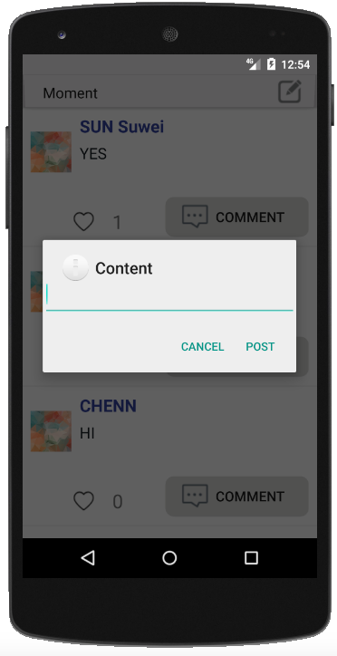
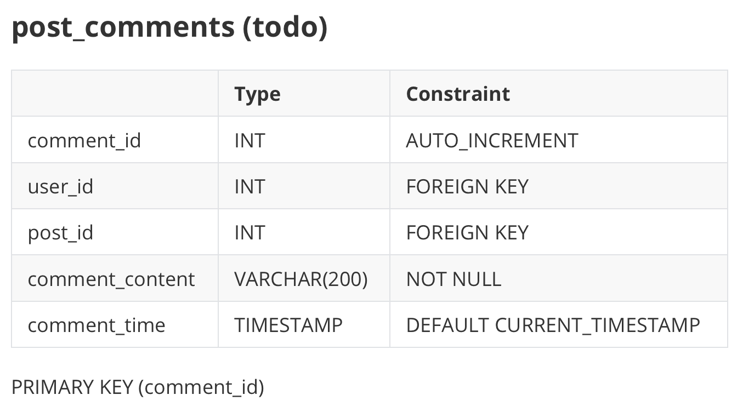
Comment

Slide 21
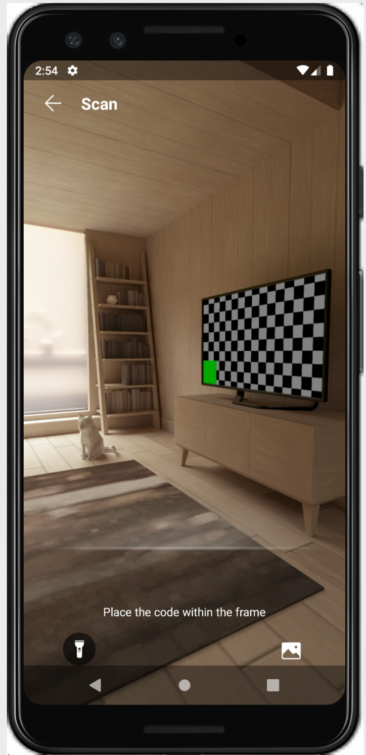
Scan QR Code
Relative libraries:
com.huawei.hms.hmsscankit.ScanUtil
com.huawei.hms.ml.scan.HmsScan
com.huawei.hms.ml.scan.HmsScanAnalyzerOptions
Steps to realize:
1. Click on the “Scan”Button
2. Turn on camera permission
3. Call functions and get QR code scanning result

Slide 22
Demo

Slide 23
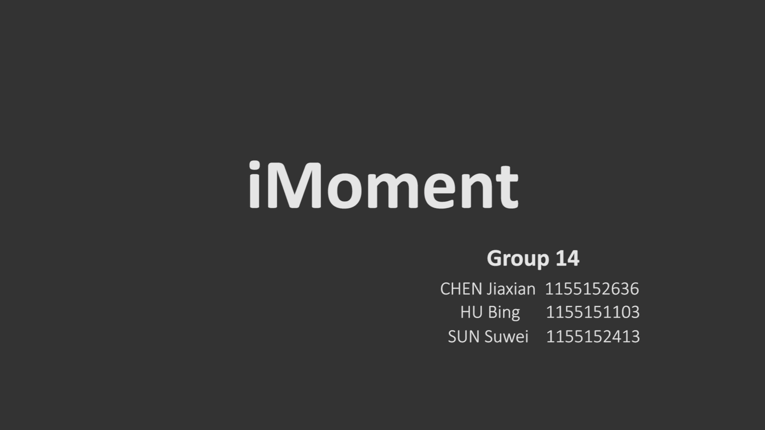

Slide 24
GitHub repo link:
https://github.com/LearnerHB/IEMS5722_Project
Notes:
So are you can see from the content, we design four features which are respectively:

Slide 25
Thank you！

